Slide 1


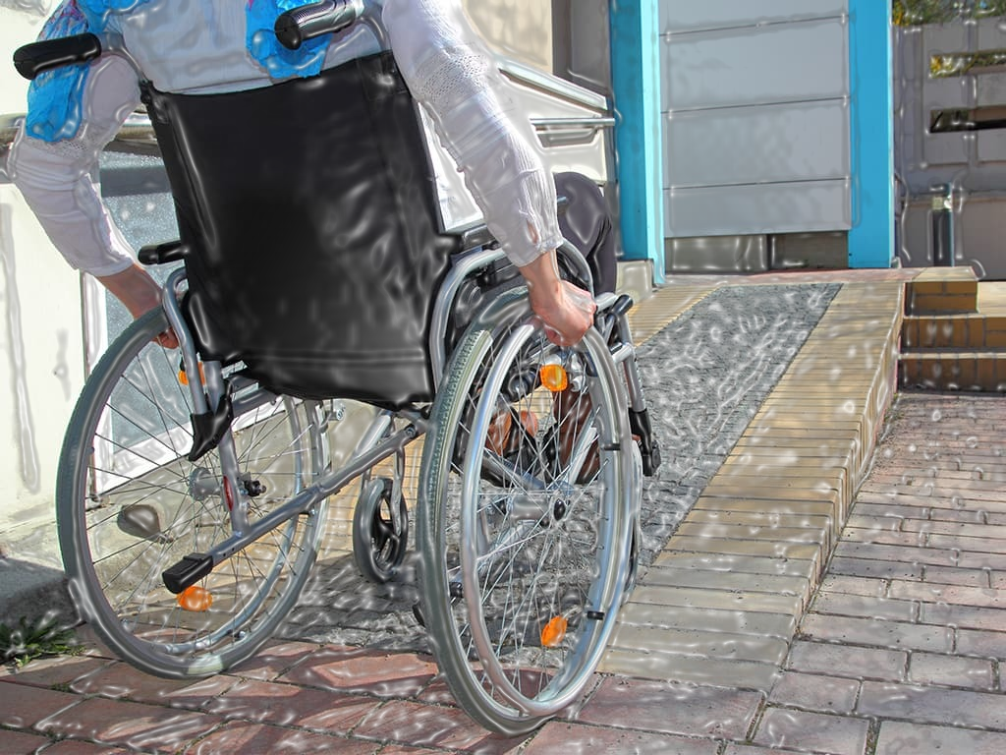
PREDICTING WHEELCHAIR ACCESSIBILITY FOR EVENT CENTERS
By:
Emmanuel Adetunji
Data scientist at National Accessibility

Slide 2
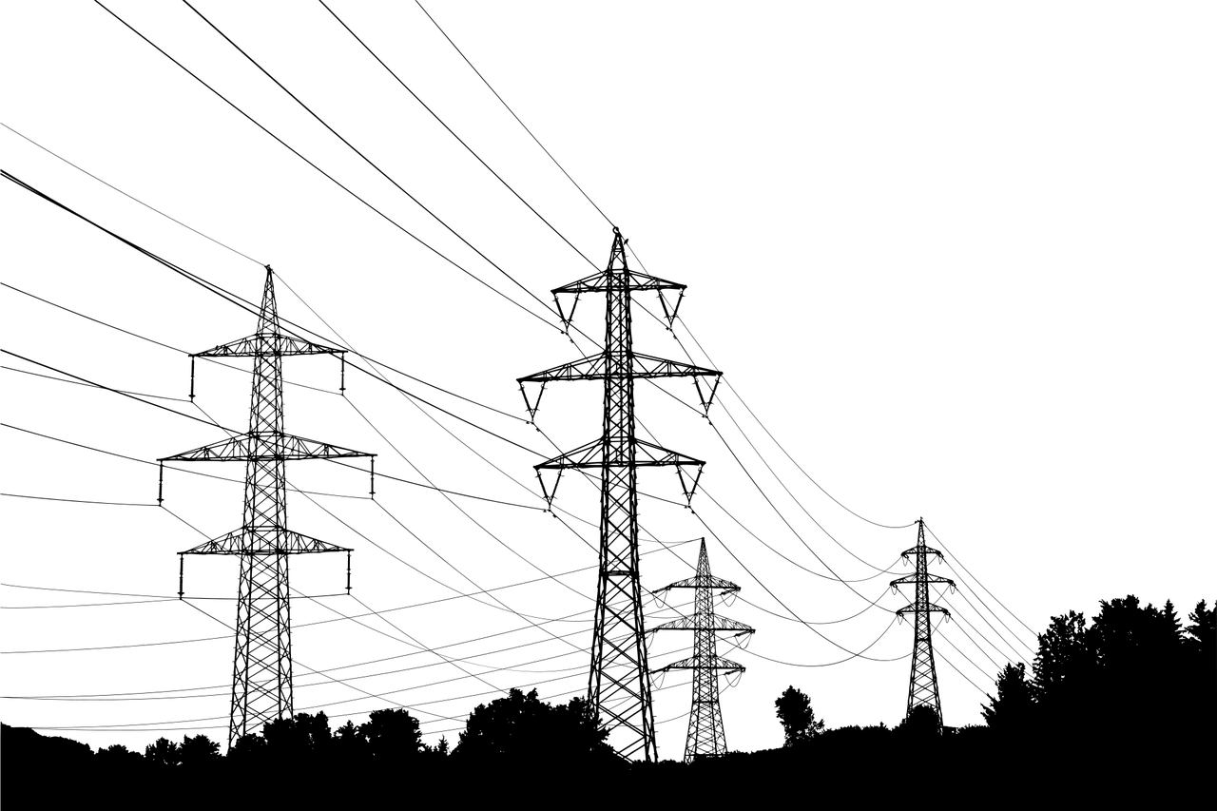
PROBLEM STATEMENT
The company is expanding its business, into installing ramps for event venues.
There is need to accurately predict which event center lack this amenities
To avoid time and resources wastage

Slide 3


PROBLEM STATEMENT CONT.
What our model will do:
Forecasts whether an event center having wheelchair accessibility.
Reduce time and resource spent.
Identify important features

Slide 4
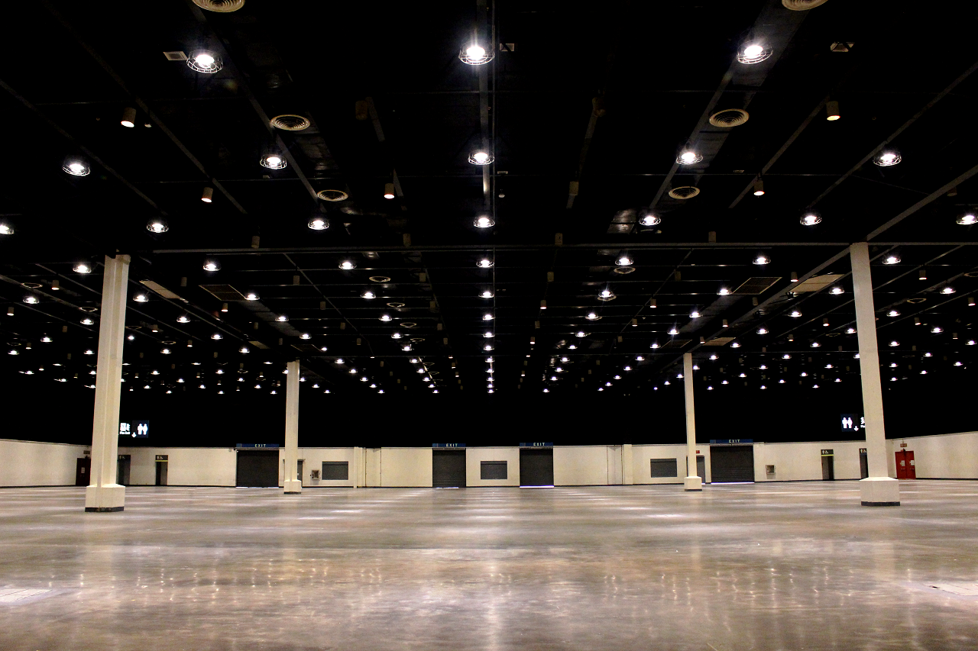
Dataset Overview: Data Talks
WHEELCHAIR RAMP
AMENITIES
RANKING
SPECIAL EVENT
CAPACITY

Slide 5
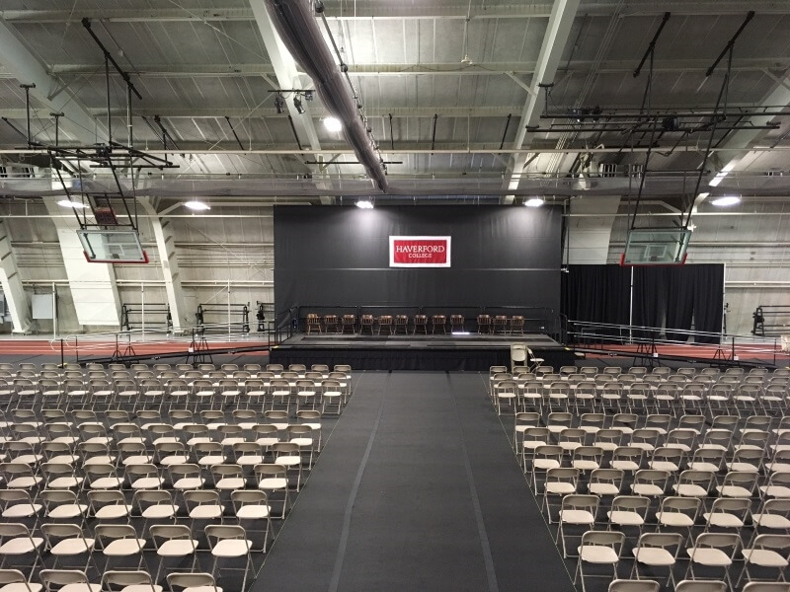
DATASET INSIGHT: DATA TALKS
After cleaning and data wrangling
Large Capacity
Special Events
Tends to have Wheelchair ramp
Super-venue
Amenities has no influence

Slide 7

DATA PATTERN: MACHINE LEARNING
Important Features
Learning from patterns
Predict YES or NO
Future Insight

Slide 8
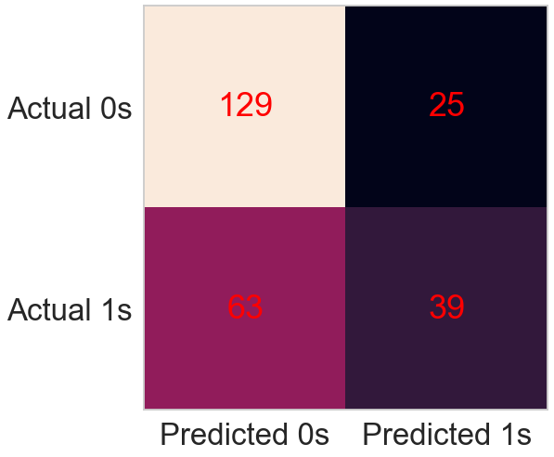
PREDICTS USING DATA PATTERNS
129 true negative predictions
63 false negative predictions
25 false positive prediction
39 true positive predictions

Slide 9

CONCLUSION
Our solution will
Predict wheelchair ramp availability.
Reduce time and resource wastage
Potential or important features

Slide 10

THANK YOU

